Slide 1

Methodologies for Determining Student Performance Risk
Robert Cilino, M.B.A. – Independent Researcher
Mohammadreza Shojaei Kol Kachi, M.S. – Keuka College
*DRAFT
*DRAFT

Slide 2
What is Performance? What is Risk?
Performance:
Retention or Persistence
Graduation
GPA
Risk:
Any
*DRAFT

Slide 3
Are there any concerns?
This should not be used to exclude certain applicants or become more selective
The later outcomes should show that we have the power to identify these “at-risk” students
We should use that power responsibly to support those students instead of excluding them
*DRAFT

Slide 4
How can we determine risk factors?
Comparing performance metrics directly
Easy, but need to be mindful of those
Comparing performance metrics in charts
Visual, easier for some to comprehend
Data needs to be structured in a specific manner
Correlation Coefficients
More difficult
Can be done with many tools – Excel, Python, Stata
All 3?
Used in different ways, helps solidify our understanding of the data
*DRAFT

Slide 5
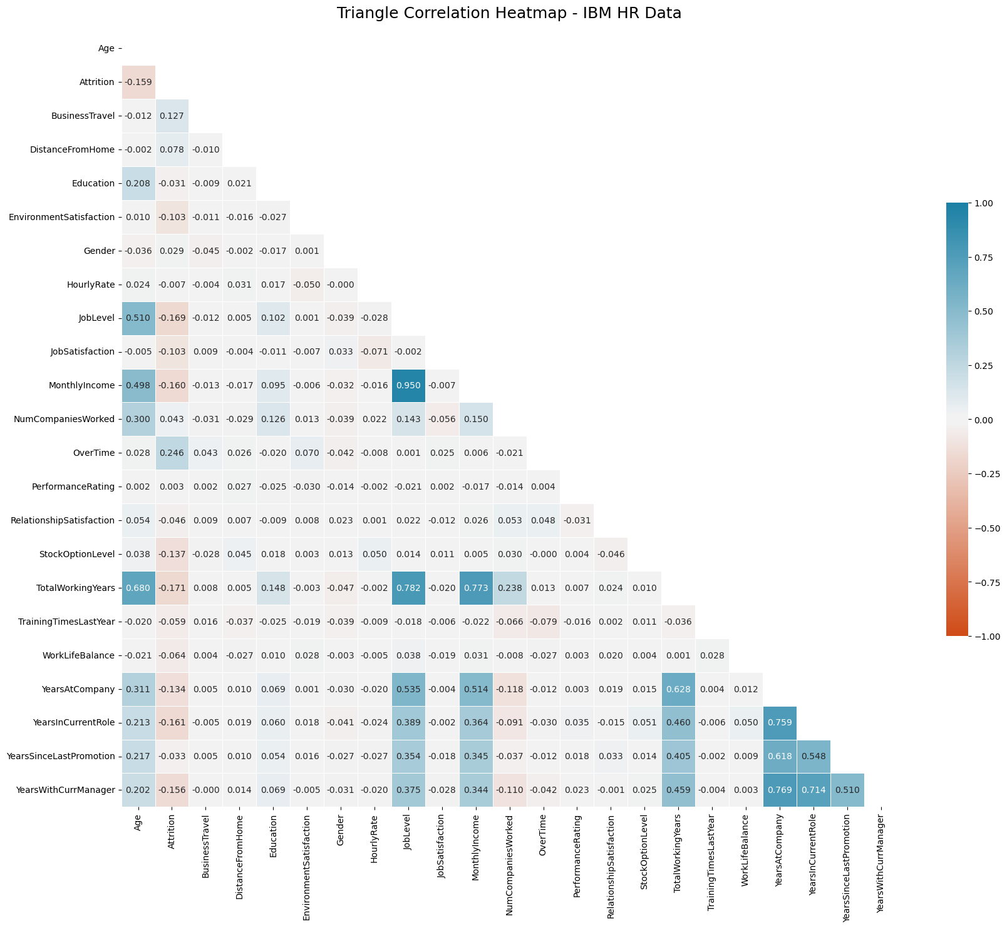
How did we determine ours?
Correlation matrix/heatmap
Helps point out relationships to investigate
Can be done in Excel as well, in a different manner
If tracking, say, retention over time data can be organized in different timeframes
Ex. 2015-2019, 2019-2023
*DRAFT

Slide 6
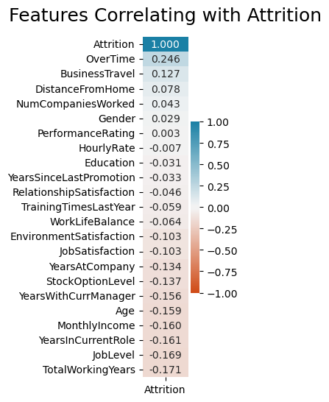
How did we determine ours?
Look directly at our performance variable
This helps reduce the clutter of the large all-encompassing matrix
Students can withdraw for many reasons, many of which cannot be measured.
*DRAFT

Slide 7
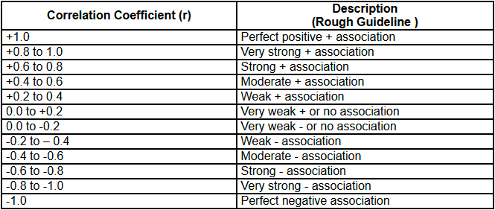
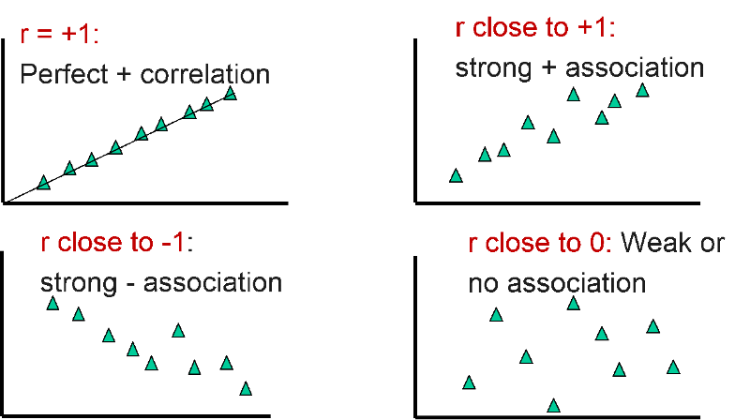
How did we determine ours?
But none of our correlations are strong
These initial correlation coefficients will look as if there is only a weak relationship.
Put many weak relationships together and you might find a strong relationship.
This is where comparing the performance metrics directly
Retention by Pell and non-Pell, by First-Gen and non-First-Gen, by ranges of High School GPA, etc.
The gaps in retention rates between those subgroups are representations of that correlation
*DRAFT

Slide 8
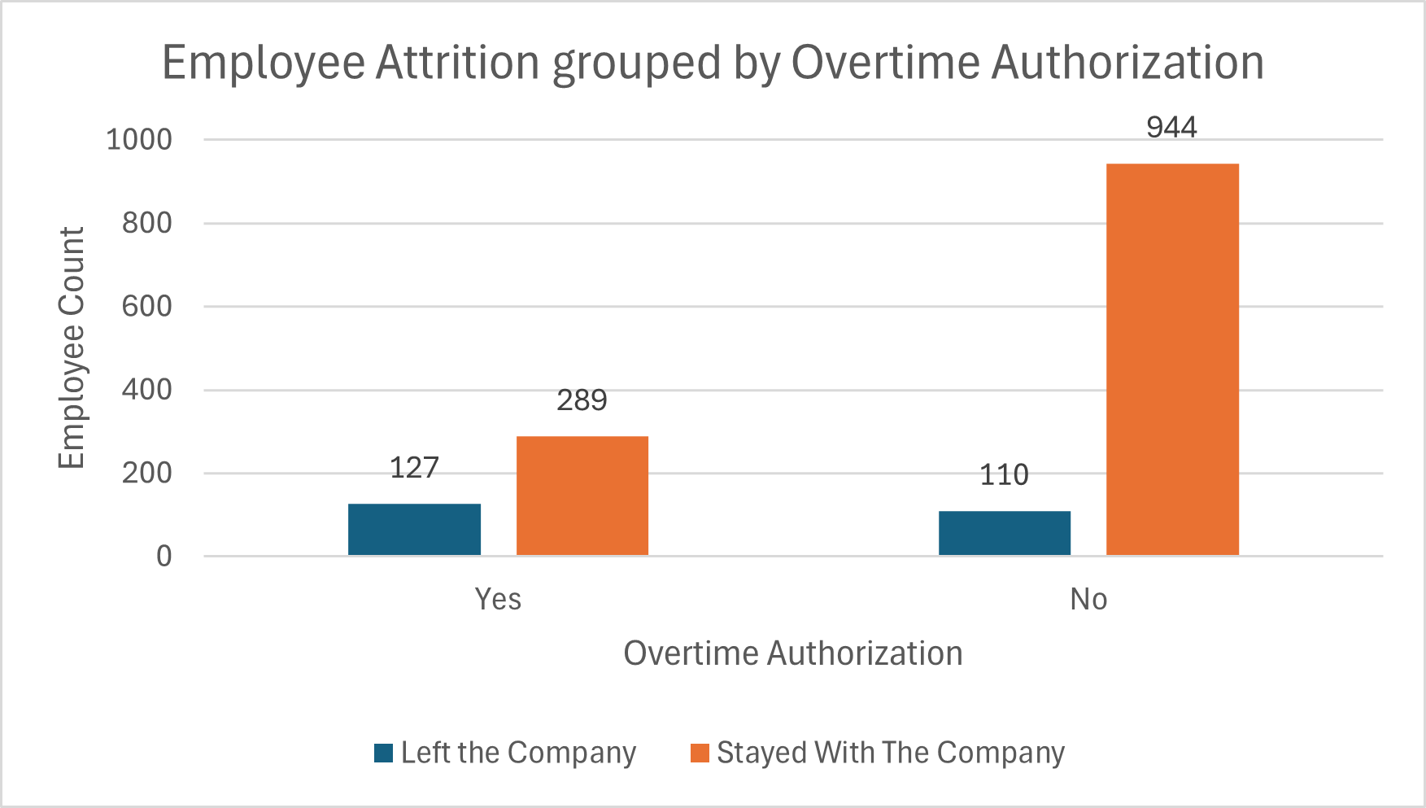
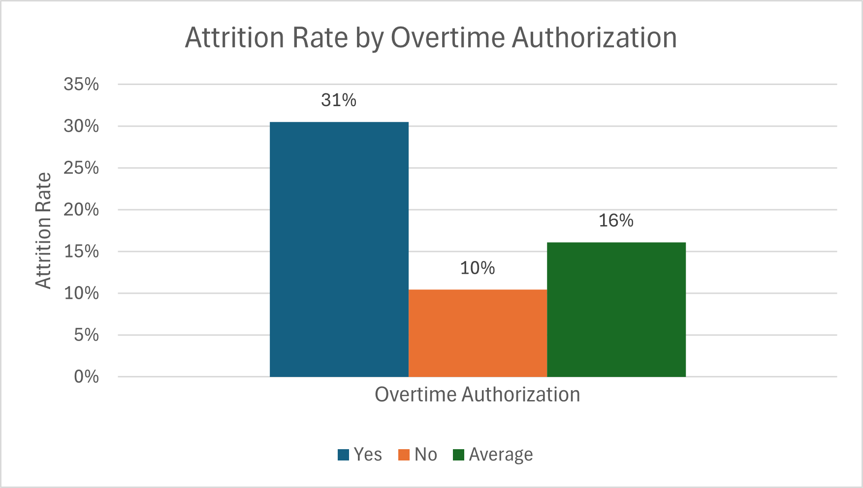
How did we determine ours?
Now that we’ve identified which student characteristics we want to examine we can look into them further
We have less Pell students than non-Pell students
Our Pell students are retained at a much lower rate
Make sure to compare our students to both the average and the opposite subgroup
*DRAFT

Slide 9
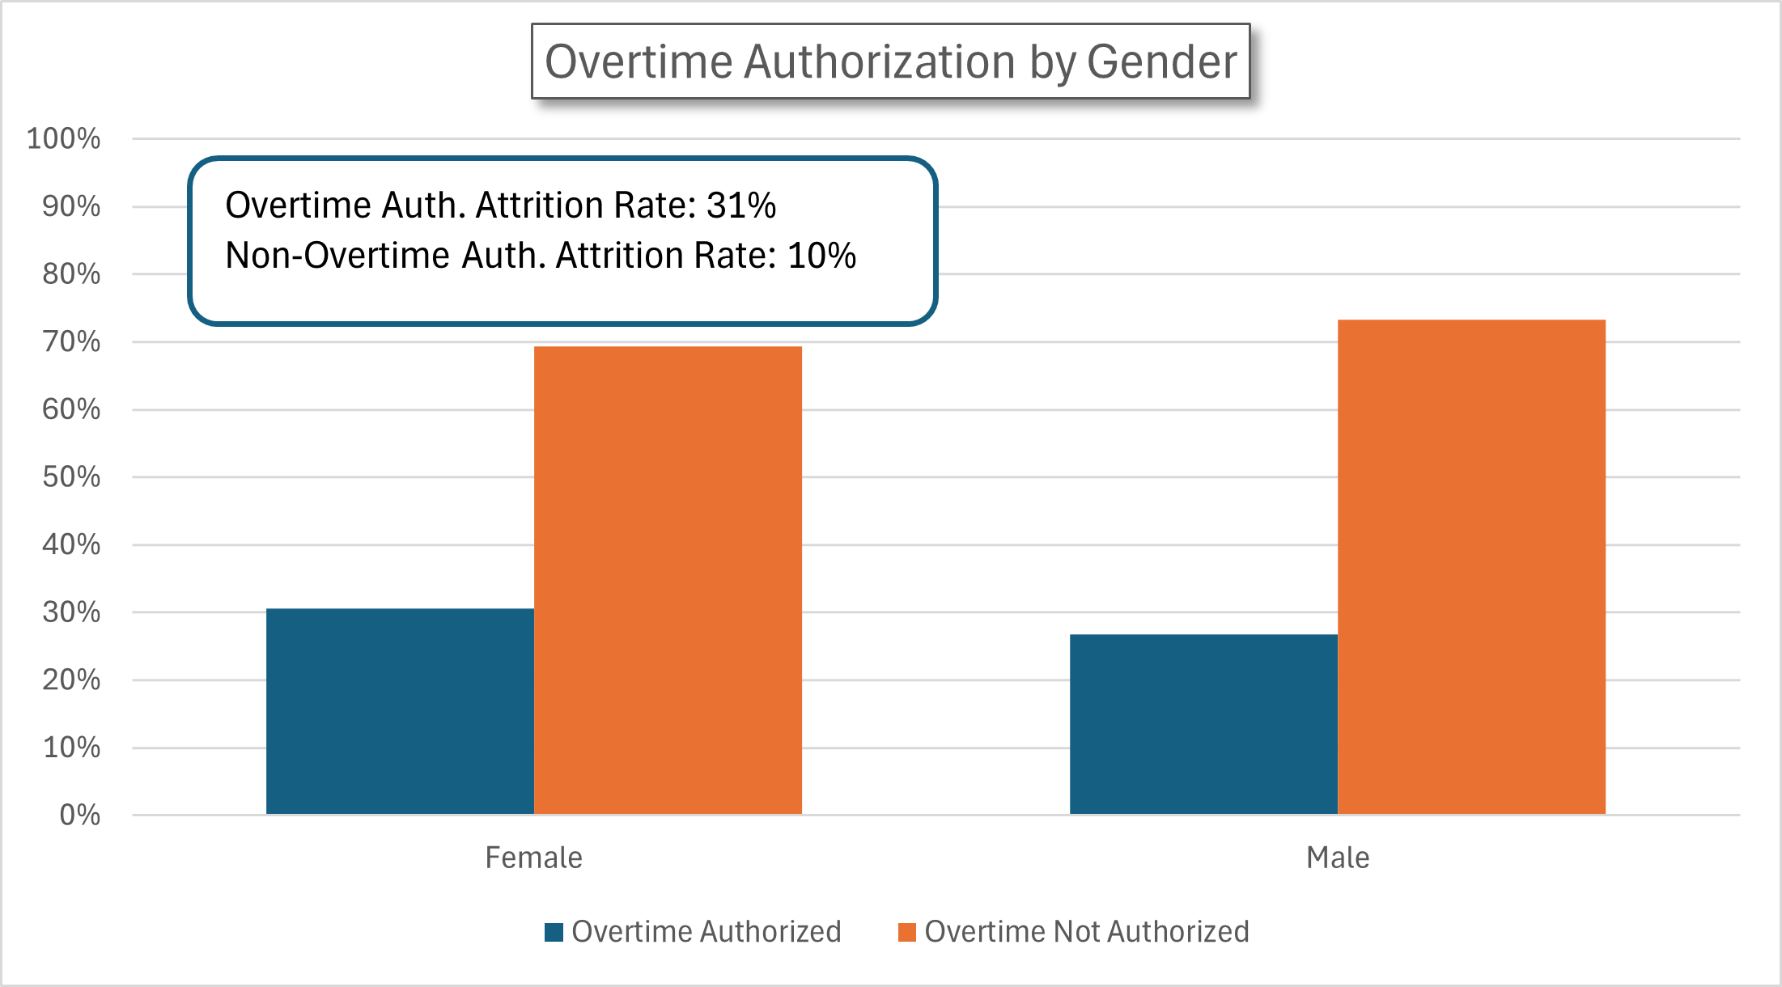
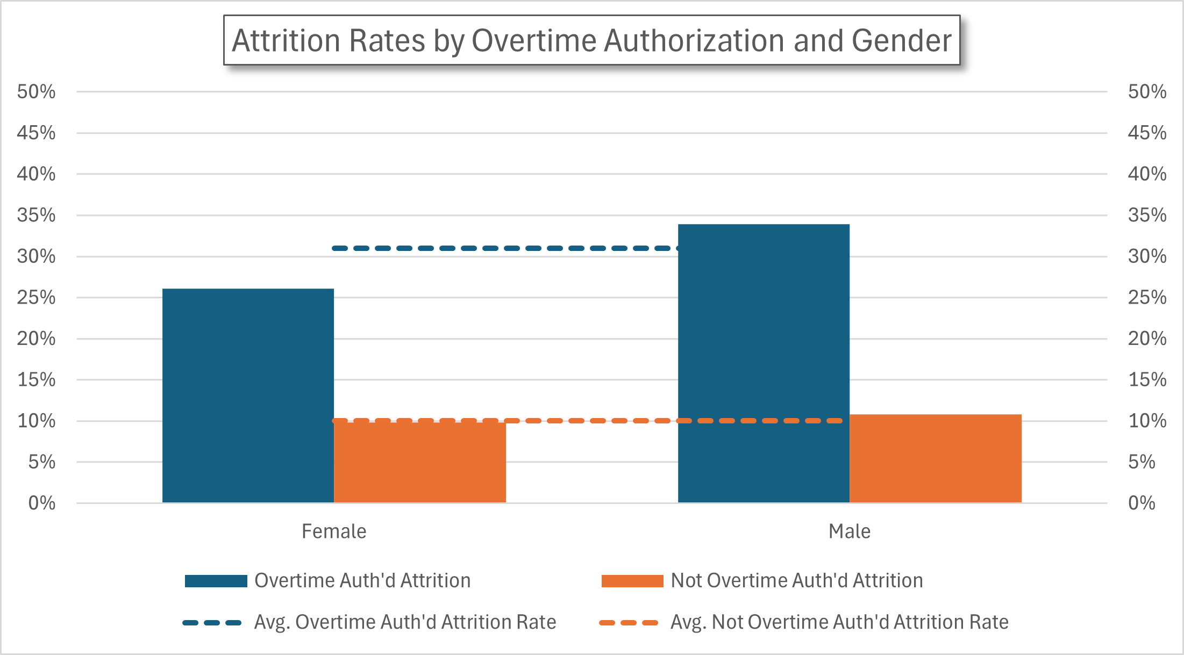
How did we determine ours?
We know our athletes have higher retention rates, let’s look there in reference to Pell status.
Our Athletes don’t experience much of a difference when comparing their Pell recipient statuses
But, our non-athletes show a great difference.
Later we determined our athletes would not receive the intervention, but we worked with the athletics department so they knew those particular athletes who might need extra attention
*DRAFT

Slide 10
So which students are “at risk”?
But none of our correlations are strong
These initial correlation coefficients will look as if there is only a weak relationship.
Put many weak relationships together and you might find a strong relationship.
This is where comparing the performance metrics directly
Retention by Pell and non-Pell, by First-Gen and non-First-Gen, by ranges of High School GPA, etc.
The gaps in retention rates between those subgroups are representations of that correlation
*DRAFT

Slide 11
So which students are “at risk”?
Through trial and error we identified our cutoff for “impactful” correlation coefficients
0.05 coefficients seemed to have enough of a measurable impact on retention rates to consider as a “risk factor”
If not using correlations, compare the retention rates of students with different characteristics and look for the largest differences
So Pell student retention % vs Non-Pell
*DRAFT

Slide 12
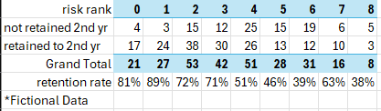
Ranking our students
Two methods
Create a hierarchy of risk factors, assign risk rankings to each student based on their combination of “risky” characteristics
Count each students’ “risky” characteristics
This doesn’t weigh any particular characteristics as more or less “risky”, but is much easier
We had 8-15 risk ranks, in the end
We verified each method and found them both accurate
Who we classified as “more at risk” had a lower retention rate, and vice versa
The first year, before we could measure our first impacted cohorts, we retroactively assigned risk ranks to the previous cohort and those student groups tracked the same. Methodology verified!
*DRAFT

Slide 13
Applying Interventions
Because we found athletes had the highest retention rates, we did not apply any interventions to that group
Year 1 we applied assigned Momentum Advisors to 50 most “at-risk” students
Year 2 the same, plus creating a new intervention that applied to those who were not athletes or the most “at-risk”
*DRAFT

Slide 14
Intervention Outcomes
In the first year we identified an increase in fall-to-spring retention rates of our students who received Momentum Advising by x%
We also identified an increase in their average GPA by x points
*DRAFT

